Slide 1
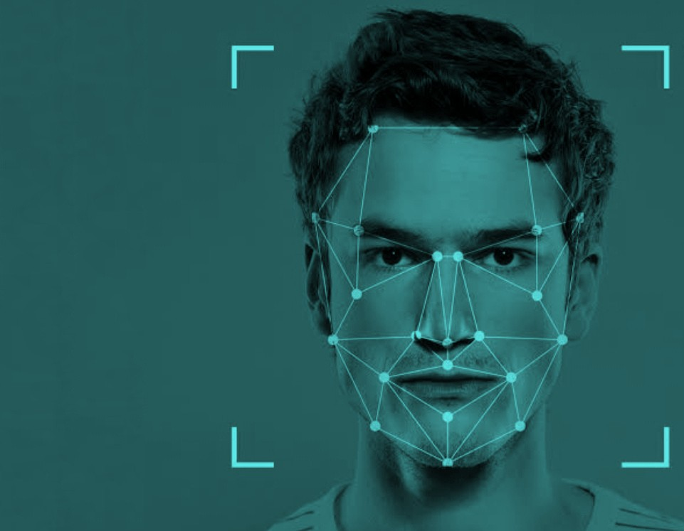
FACE RECOGNITION
ATTENDANCE
SYSTEM
By
AAKASH PAWAN G P S
18ECE34

Slide 2
SYNOPSIS
INTRODUCTION
LIBRARIES USED
ENCODING FACES
DETECTING FACES
MARKING THE ATTENDANCE

Slide 3
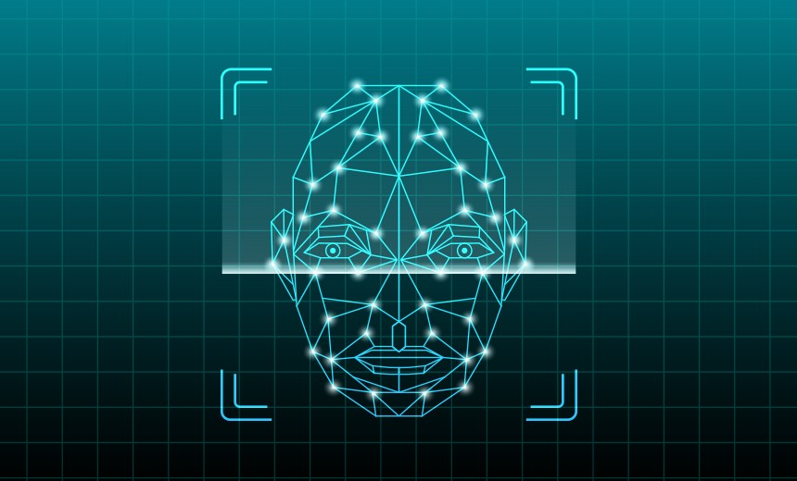
INTRODUCTION
We are in a pandemic situation over 6 months now.
Every offline things were changed to online now.
The workers have work from home and the students have online classes.
This project is to help those who are attending online classes.
This project is based on machine learning algorithms.
The main objective is to take the attendance of the students and mark it in an Excel sheet with the time they have arrived.
So let's jump into it.

Slide 4


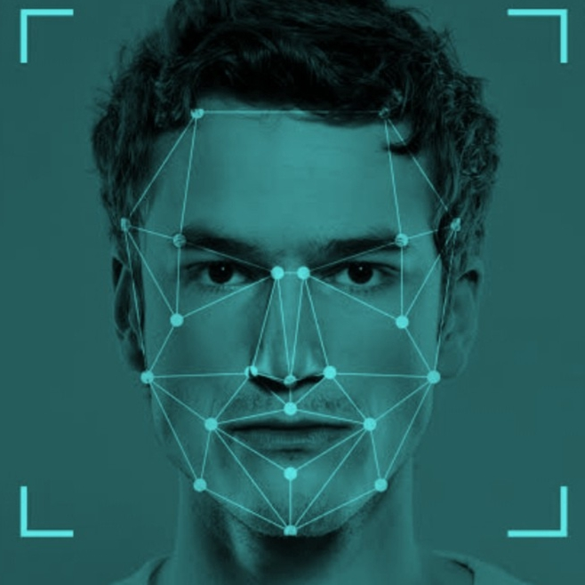


LIBRARIES USED
CV
NUMPY
FACE RECOGNITION
OS
datetime
OpenCV-Python
It is a library in python which is designed to solve computer vision problems
It is a library used for working with arrays,Linear Algebra and matrices.
Library to find , manipulate , encode and decide faces with an accuracy of 99.38%
It helps to interact the program with the operating system to read and write files on the system.
It is used to import the date and time to the program.

Slide 5
NOW GETTING INTO THE CODE

Slide 6
Summary
Here are the step by step summary of the project.
Step 1
Step 3
Step 5
Storing the images of the students in a separate folder.
and calling them using is module.
Capture the live images using webcam using "cv2.videocapture"
module.
Mark the attendance of the person with time if the person's face matches with the encoded faces.
Step 2
Step 4
Find the encodings of each of the images stored in that folder using findencodings module.
Compare the faces in the live video capture with the faces already encoded using face_encodings

Slide 7


THANK YOU

